Slide 1

WOOHP
To gang or not to gang ?

Slide 2


Hear me out
It is suspiciously similar to a gang, don't you think ?
[EXPLAIN THE EVIDENCE]
=

Slide 3


Hear me out
It is suspiciously similar to a gang, don't you think ?
[EXPLAIN THE EVIDENCE]
=

Slide 4
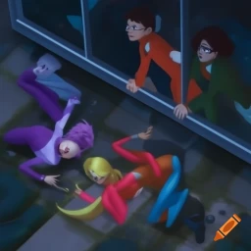
Hear me out
They even break into buildings !
=

